Slide 1

ETL PROJECT: Flight Delay Data
Calvin Brown, Sam Ettenson

Slide 2

Reason for data Manipulation
Original data source was created to track flight delays in January 2020
Table was lacking an airline name column
Made it difficult to read without prior knowledge

Slide 3
Extraction

Slide 4
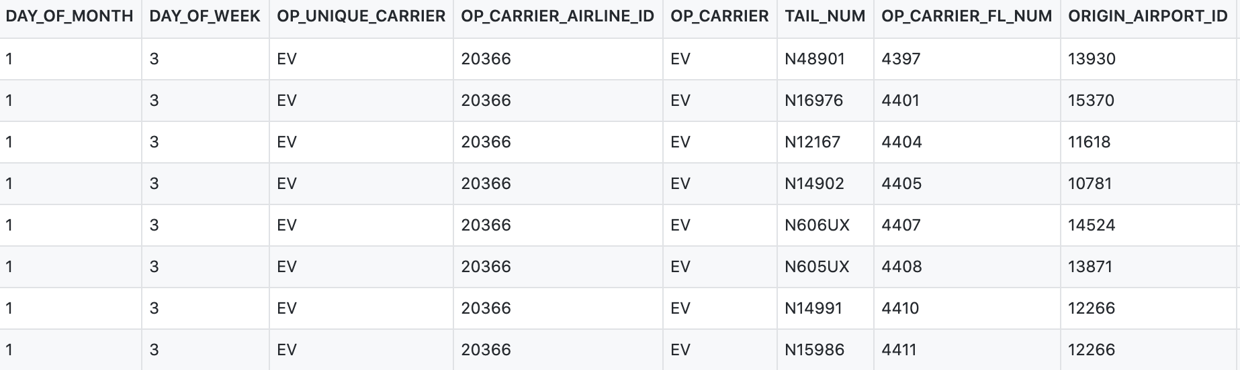
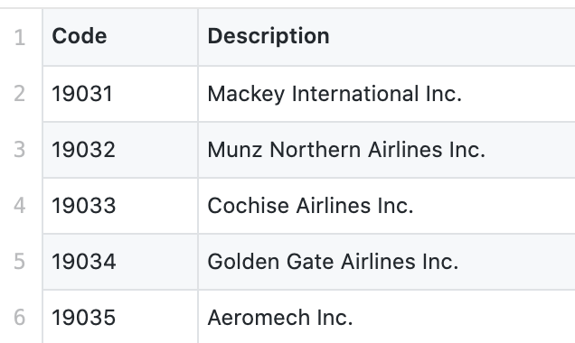
Sources of Data
Kaggle- January Flight Delay Predictions (https://www.kaggle.com/divyansh22/flight-delay-prediction?select=Jan_2020_ontime.csv ) (csv)
Bureau of Transportation Statistics (https://www.transtats.bts.gov/DL_SelectFields.asp?Table_ID=259 )(csv)

Slide 5
Transformation

Slide 6
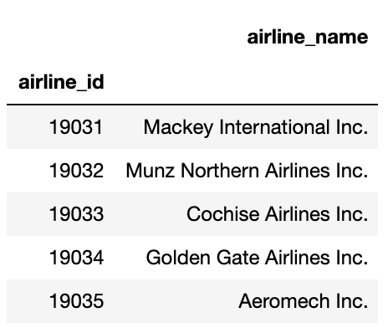
Airline Codes Table
Loaded csv into Pandas and manipulated data
Renamed Columns to make data easier to read

Slide 7
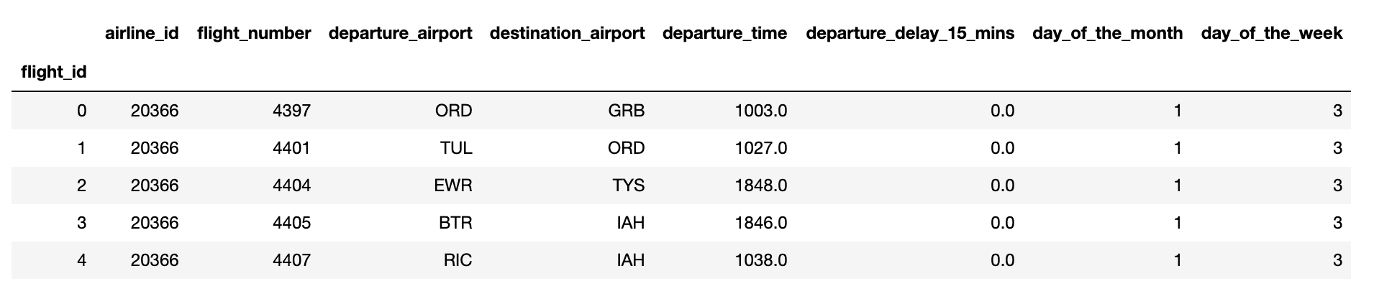
Flight Data Table
Loaded csv into Pandas
Filter the database down to grab relevant columns.
Narrowed down from 21 columns to 8 columns and renamed them make data easier to read.
Added the flight_id column to set as an index and unique value for the table to set as a Primary key in SQL.

Slide 8
load

Slide 9
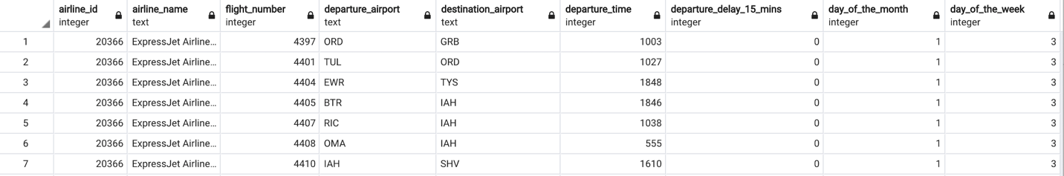
SQL Database
Created a new database in SQL (Jan_2020_flight_data_db) with two tables:
Airline Codes
Flight Data
Created a connection string between jupyter notebook and postgreSQL
Uploaded our dataframes into the tables we created in PostgreSQL.
Added airline_name column to flight data by joining both tables by airline_id

